Slide 1
Introduction to
Web Components

Slide 2
Contents
Introduction
Templates
Custom Elements
Shadow DOM
HTML Imports

Slide 3
Introduction

Slide 4
5 Problems
Undescriptive markup
Style conflicts
No native templates
No bundling
No component standard
Notes:
Undescriptive markup
generic
<div> soup
Semantic web
Style conflicts
Big centralized app stylesheet
Style clashes
Cannot encapsulate styles for component
Specific CSS selectors, !important
No native template
<script>, <style> → HTML?
iFrame
No Bundling
No native way to bundle our dependencies together
Reusable component → add all dependencies manually to app
Build component and include with single line
No standard
To create components with HTML5, Javascript and CSS natively.
Frameworks to create HTML components
1+ = struggle
Learn every vendor again

Slide 5
Solution: Web Components
Templates
Custom Elements
Shadow DOM
HTML Imports
<my-custom-element></my-custom-element>
Notes:
Web Components
Set of Web platform APIs (so no framework, but actually part of W3C web standard)
Custom, Reusable, Encapsulated HTML tags
Any JavaScript library / Framework that works with HTML
W3C: All browsers agreed on supporting this. (ng-repeat bijvoorbeeld niet)
Web Components is not a framework to include, it is part of the web ie. the browser does everything for you.
Main specifications (technologies)
Templates
Define reusable HTML markup
Custom Elements
Extend HTML by defining our own elements
Shadow DOM
Enables encapsulation of style / markup
HTML Imports
Include HTML documents in other HTML documents.
→ Bundling HTML, JavaScript and CSS into simple reusable package.
Not just custom tag
Every developer can create native HTML components
Learn Native Web Components first! (Foundation / Abstraction)

Slide 6
Why web components
Descriptive markup
Leverage existing components
Bugs easy to replace and/or upgrade
Fewer integration mistakes
Clear APIs
Notes:
Descriptive markup
Easier to read
Replace <div>s for descriptive markup
Leverage existing components
Bugs
Bundled
Encapsulated
Centralized
Fewer integration mistakes
Easy to import bundle of dependencies
Clear APIs
Web Component vs Framework

Slide 7
Level of Abstraction
Any.
Notes:
Componentizing the web → how far?
FIRST principle
Focussed - One thing, very well
Independent - to make it reusable
Reusable - should function in ANY environment
Small Testable

Slide 8
Templates
Notes:
What is it: define reusable HTML markup using web standards
Before: no standard support for HTML templates on the browser

Slide 9
<template></template>
Notes:
Contents do nothing until cloned
Contents are hidden from traditional css selectors

Slide 10
How to create a template?
Demo
Notes:
Demo

Slide 11
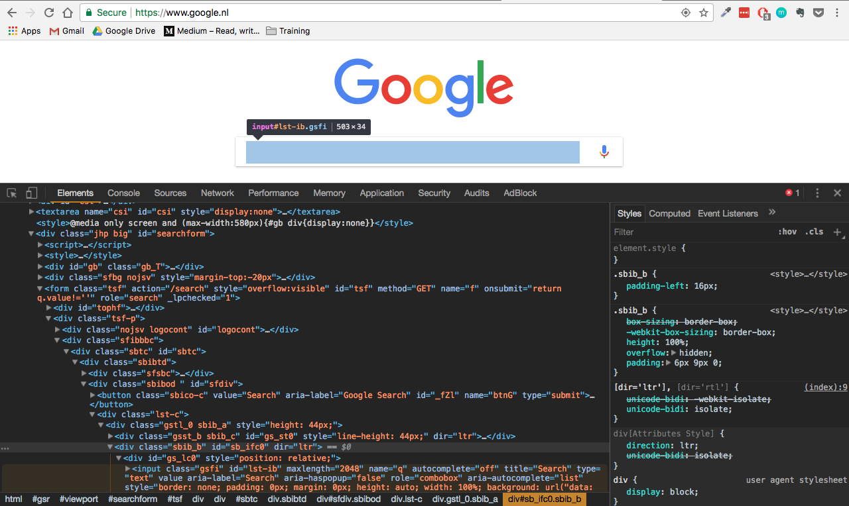
Custom Elements
<my-awesome-element></my-awesome-element>
Notes:
What is it?
Create your own HTML elements
Extend existing HTML elements
Problem: Todays markup is highly generic
<div><span>
Google example
Semantic web
Conveys additional information
Improves SEO
Enhances Accessibility
Easy to read

Slide 12
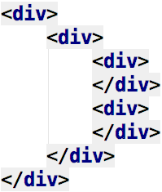
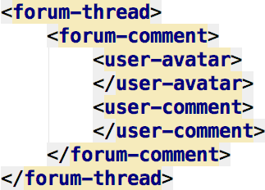

Slide 13
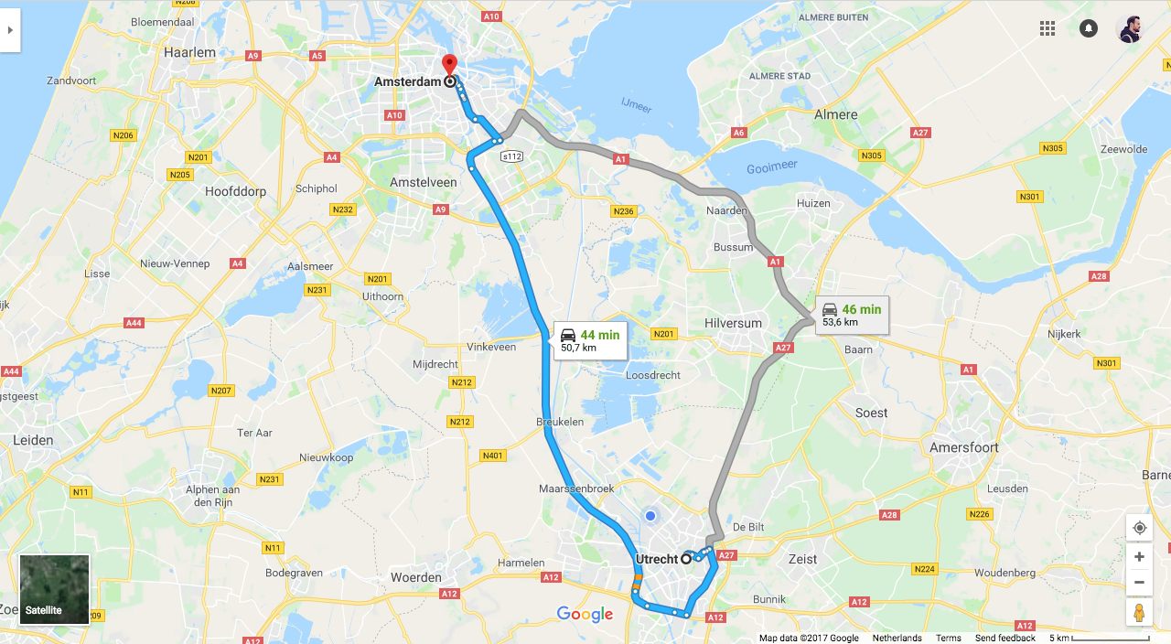

Slide 14
How to create a custom element?
Demo
Notes:
Demo

Slide 15
Custom Element Reactions
Method | Called when
constructor | Instance is created or upgraded
connectedCallback | Instance inserted into DOM
disconnectedCallback | Instance removed from DOM
attributeChangedCallback | Attributes are add, removed, or updated
adoptedCallback | When moved into a new document
Notes:
DEMO
Hooks that allow … at appropriate time in life cycle (optional)
Injecting behaviour
Performing cleanup
Initializing element
Add behaviours that make custom elements act and feel fully native

Slide 16
Shadow DOM
Notes:
Problem: Style conflicts
Centralized app stylesheet
Specific css selectors
Especially for reusable components
Resolve:
Accidentally styling other parts of page
Other accidentally style my component
Hide markup from accidental manipulation
Shadow DOM:
Create encapsulated area to define markup and styling → encapsulated subtree separate from the DOM.

Slide 17
Light DOM vs. Shadow DOM
Notes:
Light DOM = DOM you already know
Shadow DOM = subtree within the light DOM
<video> <input type=date>
Why is this awesome???
Essential for reusable components
Simpler CSS selectors
No need for wrapper <div>s for styling
Avoid accidental styling

Slide 18
How to create a shadow DOM?
Demo
Notes:
Demo

Slide 19
Slots
<my-awesome-component>
Content here…
</my-awesome-component>
Notes:
Markup in light DOM displayed in shadow DOM

Slide 20
How to create slots?
Demo
Notes:
Insertion points vs distributed nodes
<slot> creates an insertion point.
Elements inserted are called distributed nodes.

Slide 21
Event retargeting
Demo
Notes:
Many events in shadow DOM are retargeted to the host
Some Events stop instead of retargeted
Abort, error, select, change...

Slide 22
Shadow DOM Styling
Selector | Targets
:host | Shadow host
:host-context | Environment of shadow host
::slotted | Elements in <slot> tag in the shadow DOM
Notes:
New CSS selectors
It is possible to style the shadow DOM from the light DOM!!!

Slide 23
Shadow DOM Styling
Demo

Slide 24
HTML imports
<link rel=”import” href=”my-awesome-component.html”>
Notes:
What is it: It allows us to import HTML file into another HTML file.
→ Package complete component to be used somewhere else
<link> CSS
<script> JavaScript
NOTE: HTML imports is deprecated and replaced by ES6 imports.
It achieves the same thing, but in a different way.

Slide 25
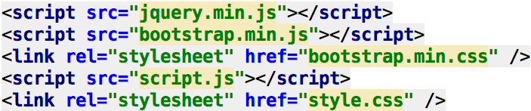
Why is this awesome?
Notes:
Consider web component that uses bootstrap.
Add dependencies separately
It’s all about how easy it is to use a web component.

Slide 26
Imports
Demo

Slide 27
Bye!
Notes:
Assignment
Push web components to project

